Slide 1
Information Technology Institute (ITI)
Virtual Office Management
Session 6 & 7 PowerPoint
ITI 490 Virtual Office Management - with Microsoft 365
(formerly Office 365)
Notes:
CANNOT EDIT PURPLE SHAPES OR LOGO
DIVIDER LINE IS EDITABLE
TO CHANGE IMAGE, RIGHT CLICK IMAGE, SELECT “CUT” TO REMOVE EXISTING IMAGE, AND CLICK IMAGE ICON TO INSERT NEW IMAGE
IF NO IMAGE IS IN PLACE, CLICK IMAGE ICON TO INSERT IMAGE

Slide 2
PowerPoint

Slide 3
Class Outline
Session 6 – Part I
Session 7 – Part II
Introduction
Getting Started
Working with Slides
Images and Shapes
Adding Diagrams and Charts
Add Video, Audio, Animation
Helpful Accessibility Features
Collaborate
Deliver Presentations
Reuse Presentations
Challenges

Slide 4
Getting Started
Theme of Template
QuickStarter Outline Tool
Create and Save New Presentation

Slide 5
Working with Slides
Add, Remove, and Rearrange Slides
Change the Slide Layout
Change the Slide Color and Background
Change All Slides with Slide Masters
Add your own Text Boxes
Use Designer

Slide 6
Images and Shapes
Add Images
Working with Shapes
Format and Add Effect to Objects
Align Object with Arrange Tool
Understand Object Layering
Group Object and Format Painter
Remove Background from Pictures
Group Shapes Together
Copy Images to Shapes

Slide 7
Adding Diagrams and Charts
Create and Format Charts
Use SmartArt to Create Diagrams

Slide 8
Add Video, Audio, Animation
Add and Format Video
Add and Work with Audio Files
Add Animation to Objects and Text
Add Slide Transitions
Use Morph to Create Animations
Use Zoom to Create Animations
Include Live Webcam Video with Cameo

Slide 9
Helpful Accessibility Features
Features for PowerPoint Users w/Disabilities
Create Accessible Presentations

Slide 10
Collaborate
Add Speaker Notes
Rehearse with Timings and Presenter
Share and Collaborate on a Presentation
View Previous Revisions

Slide 11
Deliver Presentations
Use Presenter View
Run Unattended SlideShows

Slide 12
Reuse Presentations
Save a Custom Theme
Save A Presentation as a Template
Record and Export a Presentation
Export as a PDF, JPEG, or GIF

Slide 13
Challenges
TBD

Slide 14
Comparison of Desktop, Web, and Mobile Versions
PowerPoint on the Desktop
PowerPoint for the Web
PowerPoint Mobile App
Install and access on a local computer
Comprehensive feature set
Complete user interface
Access from any web browser
Streamlined feature set
Simplified user interface
Download app to your tablet or phone
Limited feature set
Adaptable (responsive) user interface

Slide 15
Getting Started with Microsoft PowerPoint
Navigate the PowerPoint Environment
View and Navigate a Presentation
Create and Save a Basic Presentation
Navigate in PowerPoint for the Web
Use PowerPoint Help

Slide 16
Navigate The PowerPoint Environment

Slide 17
Microsoft PowerPoint

Slide 18
Slides
Slides: Individual presentation objects that are used to display text and visual content to the audience

Slide 19
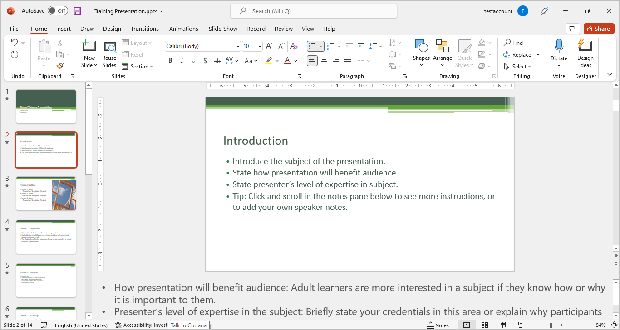
Notes
Notes pane: A component of the user interface that allows users to enter notes that can be referenced during the delivery of a presentation
Notes Pane
Notes Button

Slide 20
The Thumbnails Pane
Thumbnails Pane

Slide 21
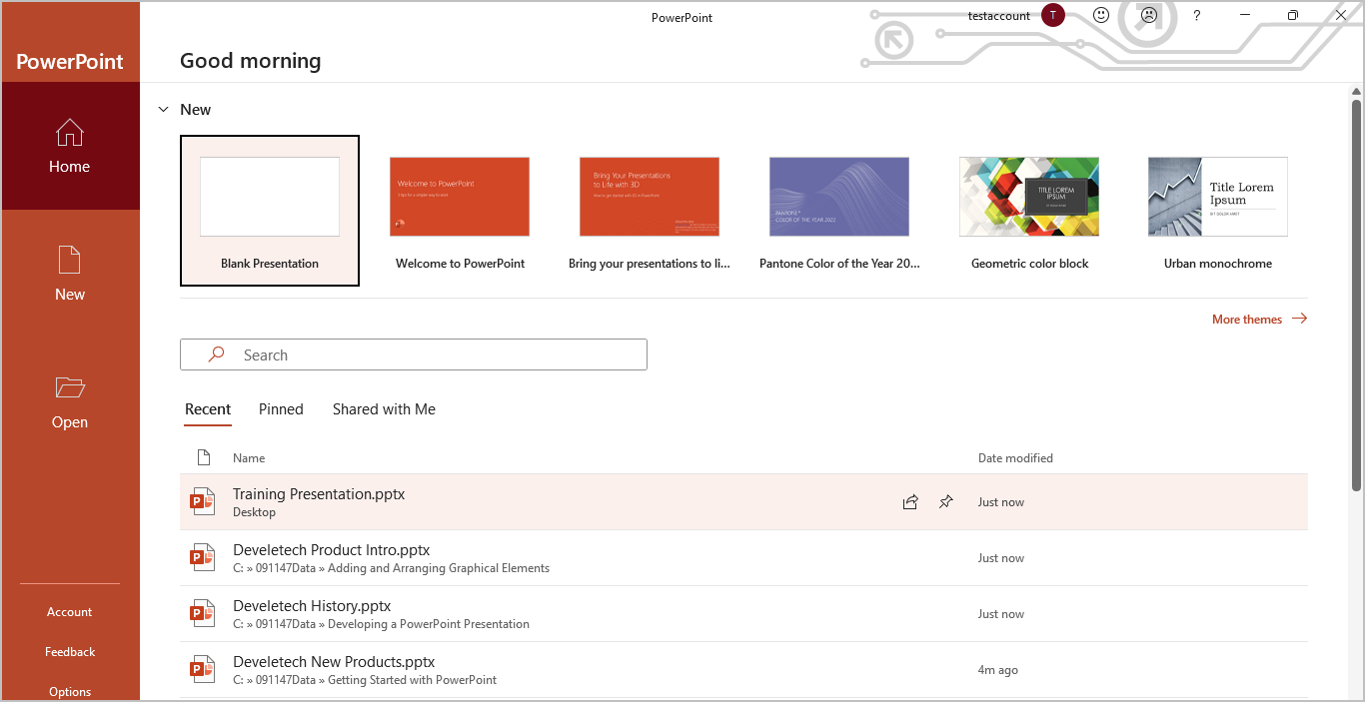
The Start Screen
Resources to create new presentations
Saved Files
Recent Files

Slide 22
The PowerPoint User Interface

Slide 23
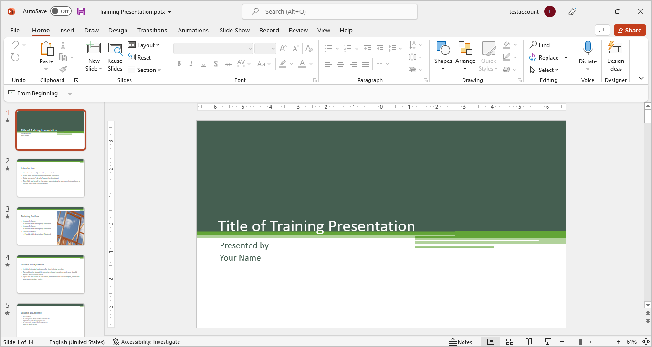
The PowerPoint User Interface
Title Bar
Ribbon
Slide Pane
Quick Access Toolbar
Thumbnails Pane
Status Bar

Slide 24
The Ribbon
Tabs
Command
Groups
Ribbon Display Options Button

Slide 25
Dialog Box Launchers
Dialog Box Launchers

Slide 26
Galleries
More

Slide 27
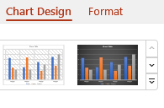
Contextual Tabs
Contextual Tabs

Slide 28
The Ribbon Tabs (Slide 1 of 2)
Ribbon Tab | Provides You with Access To
File | Commands to create, open, save, close, share, and print files.
Home | Commands to add and edit text, add slides, and insert basic visual objects.
Insert | Commands for adding and working with objects, such as charts, tables, and images.
Draw | Tools for freehand drawing using a mouse, touchpad, or touch screen.
Design | Options for tailoring the overall visual design of your presentation.
Transitions | Options for creating visually appealing progressions between slides.

Slide 29
The Ribbon Tabs (Slide 2 of 2)
Ribbon Tab | Provides You with Access To
Animations | Commands to add and edit dynamic effects to objects on slides in your presentation.
Slide Show | Functions you will use to rehearse and deliver your final presentation.
Record | Commands for recording slide shows, capturing screenshots, and exporting presentations in formats that don't require the viewer to have PowerPoint.
Review | Options for reviewing and revising the content in your presentation.
View | Commands that allow you to alter how you view your presentation.
Help | Commands for accessing PowerPoint documentation, contacting support, providing feedback to Microsoft, and viewing training videos.

Slide 30
View and Navigate a Presentation

Slide 31
Presentation Views – Normal

Slide 32
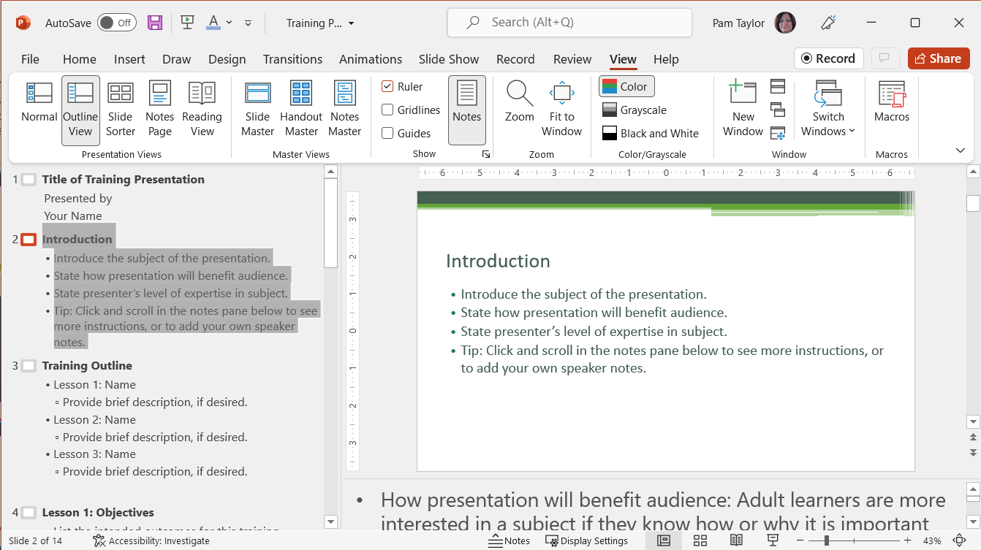
Presentation Views – Outline View

Slide 33
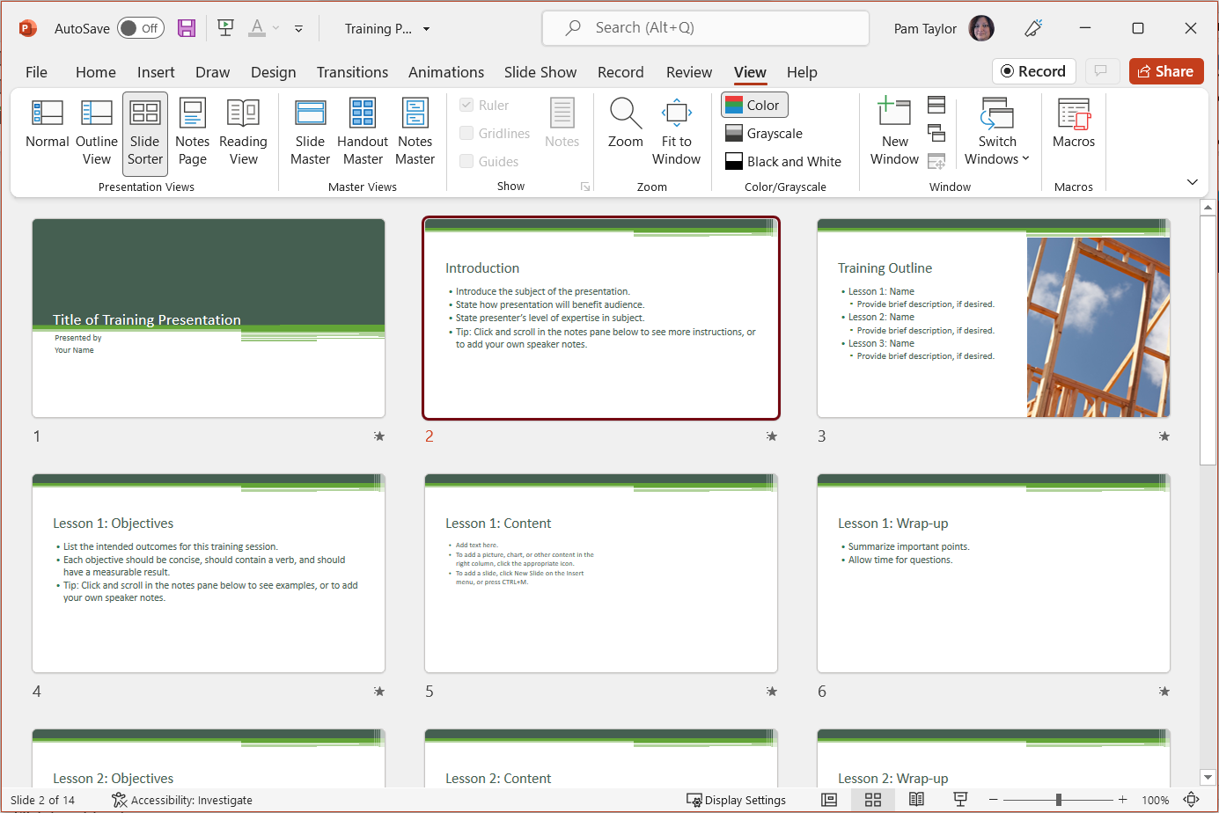
Presentation Views – Slide Sorter

Slide 34
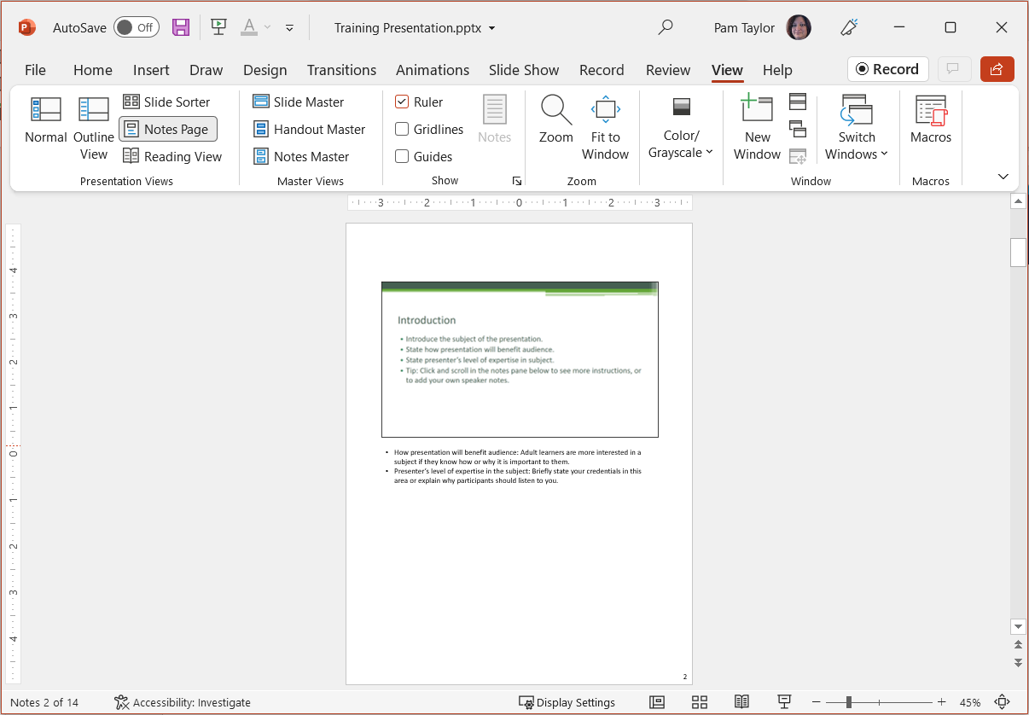
Presentation Views – Notes Page

Slide 35
Presentation Views – Reading View

Slide 36
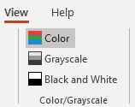
Color View Options
Color view options
Grayscale view

Slide 37
Slide Show Options
Action | Mouse Action | Keyboard Shortcut
Start from beginning | Select Slide Show→From Beginning | Press F5
Start from current slide | Select Slide Show→From Current Slide | Press Shift+F5
Go to specific slide | N/A | Press <slide number>+Enter
Advance to next slide | Click on the screen Right-click and select Next | N, Enter, Page Down, Right Arrow, Down Arrow, Spacebar
Return to previous slide | Right-click and select Previous | P, Page Up, Left Arrow, Up Arrow, Backspace
Black out/restore | N/A | Press the B key
White out/restore | N/A | Press the W key
End | Right-click and select End Show | Press the Esc key

Slide 38
Create and Save a Basic Presentation

Slide 39
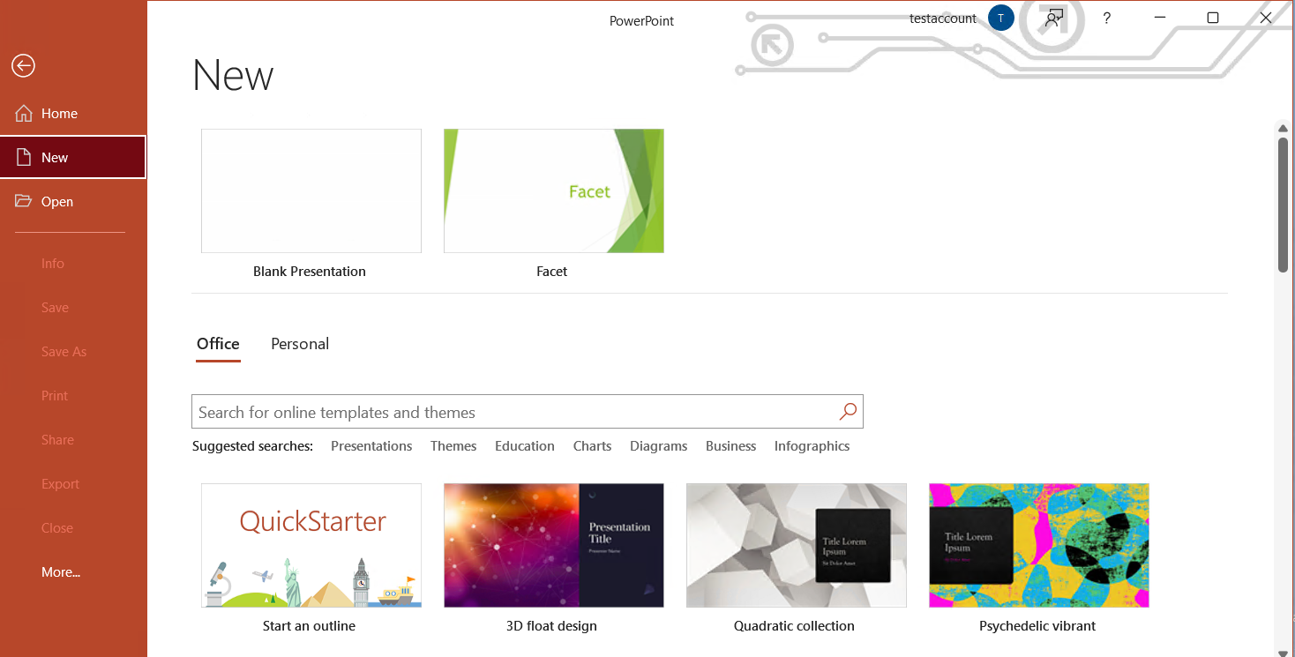
The New Screen

Slide 40
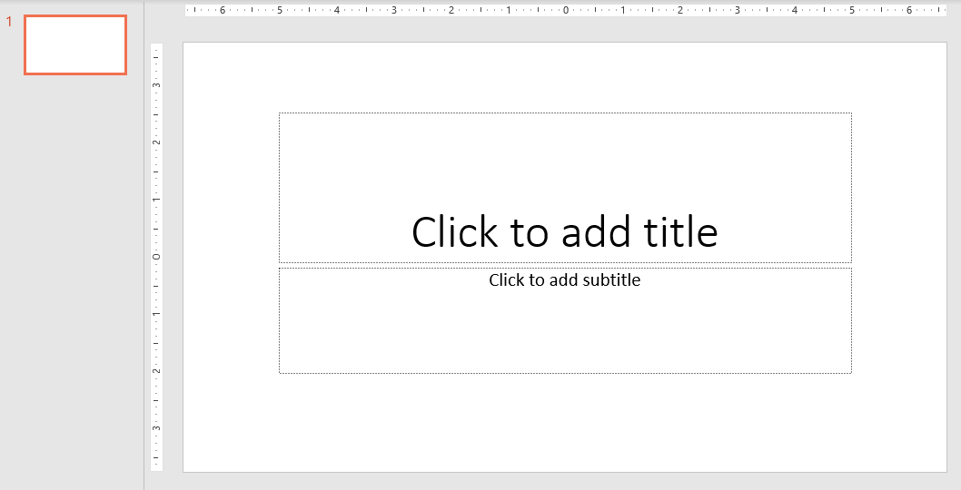
Blank Presentation
Title Text
Placeholder
Subtitle Text
Placeholder

Slide 41
Text Placeholders
Text placeholders: Containers for instructional text indicating the type of content users should enter.
Slides can contain multiple placeholders.
Position and format of placeholders determined by Slide Master.
Avoid manual modifications to placement or format.

Slide 42
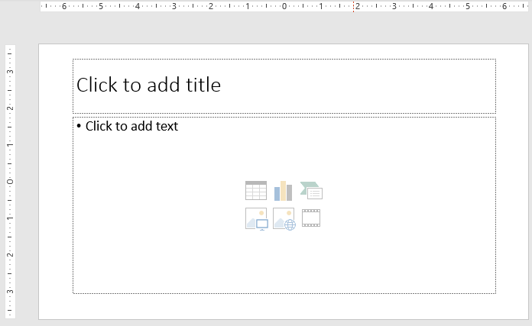
Content Placeholders
Select here to add text
Content Placeholder
Select an icon to add that content type

Slide 43
Use PowerPoint Help

Slide 44
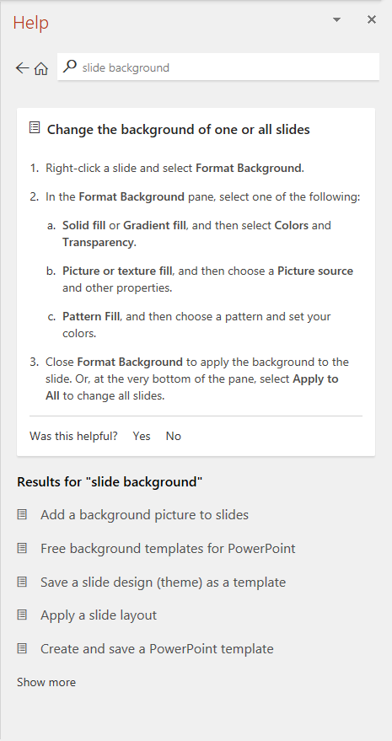
PowerPoint Help
Help Home Button
Search Help Field
Suggested Content
Search Results

Slide 45
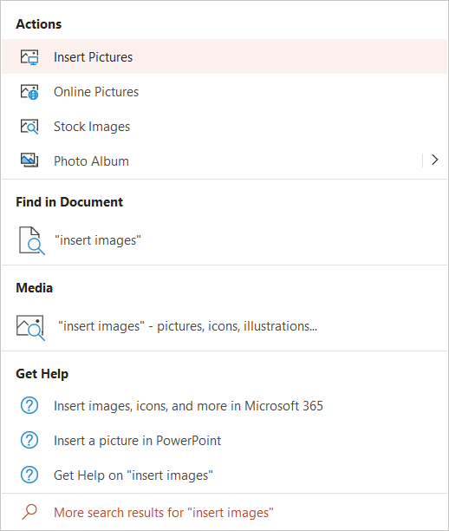
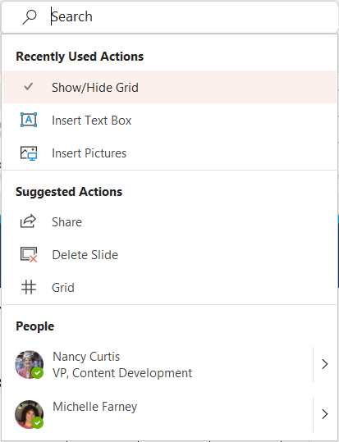
The Microsoft Search Feature
Search term
Select an action to complete the command
Search within the document
Get help from Microsoft or an Internet search
Julia Majors
Kai Bruno

Slide 46
Developing a PowerPoint Presentation
Create Presentations
Edit Text
Work with Slides
Design a Presentation

Slide 47
Create Presentations

Slide 48
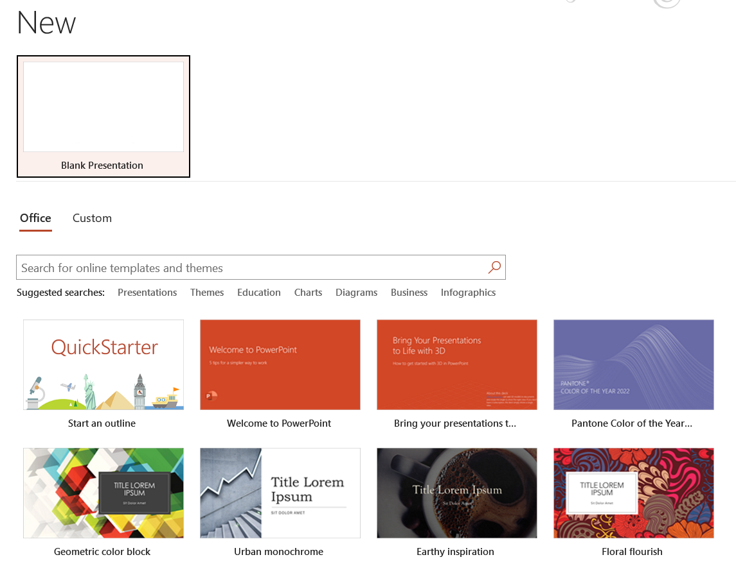
Methods to Create Presentations
Blank Presentation
Templates and
Themes Search Tools
Themes Included with PowerPoint

Slide 49
Templates
Template: An existing presentation that contains content placeholders that are already formatted

Slide 50
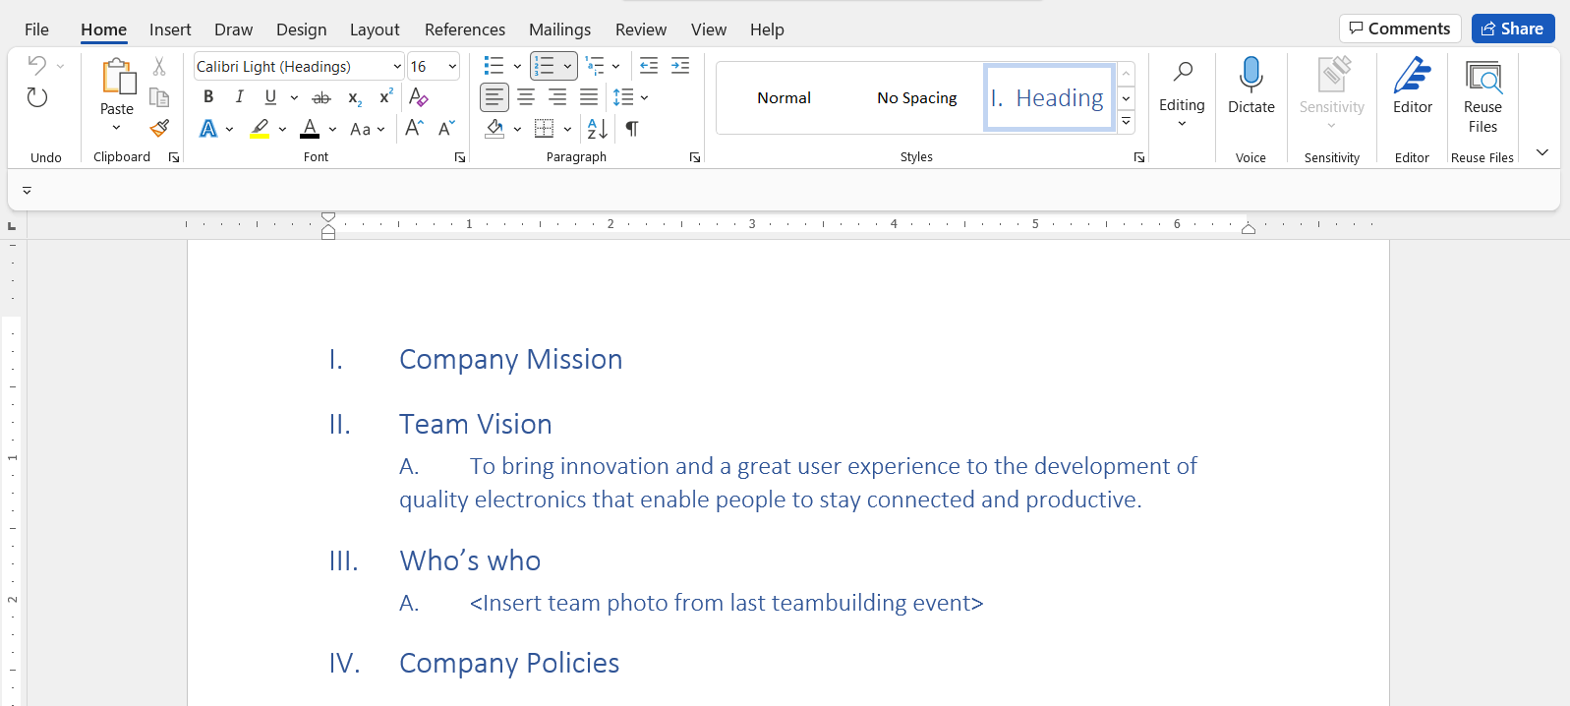
Word Outline
Slide Title
Heading 1
Bullet point
Heading 2
Word document containing heading styles
PowerPoint presentation based on the Word document

Slide 51
Edit Text

Slide 52
Text Boxes
Text boxes: Blank containers for adding text to slides in PowerPoint
Sizing handles: Components of the borders of a selected object that allow users to increase and decrease the height and length of objects on slides
Rotation handle: Component of the borders of a selected object that allows users to turn objects on slides in a circle
Border
Rotation Handle
Sizing Handles

Slide 53
Text Selection Methods
Text Selection | Method
Specific section of text | Click and drag with mouse. Place cursor to the left of text. Then, press and hold the Shift key and click to the right of last character of text you wish to select. Place cursor next to text. Then, press and hold the Shift key and use arrow keys to extend the highlighted portion of text in any direction.
A single word | Double-click the word.
A paragraph or a bulleted item | Triple-click the text.
Non-contiguous sections of text | Select first section of text. Then, press and hold the Ctrl key, and select the next desired section of text.
All text within a selected text placeholder or text box | Press Ctrl+A. Select Home->Select->Select All.

Slide 54
The Mini Toolbar
Increase/Decrease Font Size
Increase/Decrease Indent
Font Type
Font Size
Insert a Comment
Paragraph Settings
Font Style
Highlighter
Bullets
Align
Font Color
Line Spacing
Format Painter

Slide 55
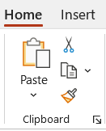
The Cut, Copy, and Paste Options
Function | Keyboard Shortcut
Cut | Ctrl+X
Copy | Ctrl+C
Paste | Ctrl+V

Slide 56
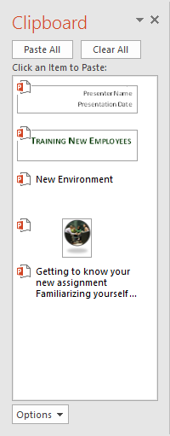
The Clipboard

Slide 57
The Clipboard Paste Options
Paste Option | Icon | Effect
Use Destination Theme |  | The formatting of the destination text box or placeholder is applied to pasted text.
Keep Source Formatting |  | The pasted text retains its original formatting.
Picture |  | The text is pasted as an image.
Keep Text Only |  | Only unformatted text is pasted.

Slide 58
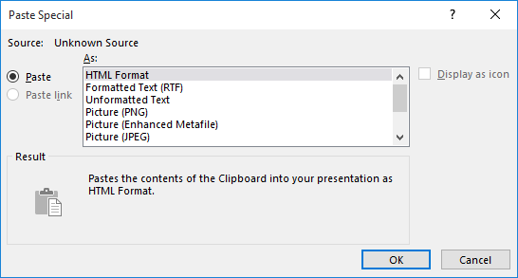
The Paste Special Command
Paste Special command: Allows you to paste items to a new location as a specific type of file

Slide 59
Work with Slides

Slide 60
Slide Actions
Insertion
Reuse
Duplication
Deletion
Hide

Slide 61
Slide Layouts
Slide layout: A template that determines the placement of different types of content on a slide
Placeholders for items such as text, tables, and images are built into the layouts
You can:
Select slide layouts as you add slides to your presentation
Apply slide layouts to existing slides

Slide 62
Types of Slide Layouts (Slide 1 of 2)
Slide Layout | What it Includes
 | Text placeholders for a title and a subtitle.
 | A text placeholder for a slide title and a content placeholder.
 | Text placeholders for section and subsection titles.
 | A text placeholder for a slide title and two content placeholders.
 | A text placeholder for a slide title, two content placeholders, and two text placeholders for labels.

Slide 63
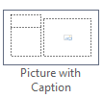
Types of Slide Layouts (Slide 2 of 2)
Slide Layout | What it Includes
 | A text placeholder to enter a slide title.
 | No placeholders.
 | A text placeholder for a slide title, a text placeholder for textual content, and a content placeholder.
 | A title text placeholder, a picture placeholder, and a text placeholder for caption text.

Slide 64
Slide Size and Orientation Settings
Widescreen (16:9)
Standard (4:3)

Slide 65
Arrange Your Slides

Slide 66
Slide Arrangement
Dragging slide 4 to become slide 3

Slide 67
Design a Presentation

Slide 68
Visual Design
Design is not decoration
Visual design is about clear presentation of ideas
Informative visuals have three elements:
Text
Graphic objects
White space
Clear communication requires:
Simplicity – no extra elements
Harmony – an organized balance of elements

Slide 69
Working with Themes

Slide 70
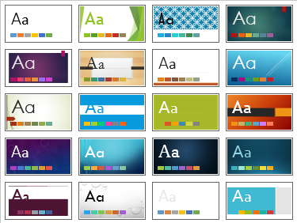
Themes
Theme: A combination of colors, fonts, and effects that provides a consistent look and feel throughout a presentation

Slide 71
Theme Components
Theme Component | Description
Colors | Determine the color applied to particular on-slide elements.
Fonts | Apply a different font to title text and the body text on slides.
Effects | Apply effects to on-slide elements.

Slide 72
Theme Variants
Theme variants: Collections of closely related themes that share many of the same layout and design elements, but with some changes

Slide 73
Background Fills
Solid fill
Gradient fill
Image
Texture
Pattern

Slide 74
The Format Background Pane
Tab Option | Icon | Allows You To
Fill |  | Access options for creating solid, gradient, picture or texture, and pattern fills.
Artistic Effects |  | Apply artistic effects to background images and textures.
Picture |  | Adjust the sharpness, brightness/contrast, and picture color of pictures that are being used as backgrounds.

Slide 75
Using PowerPoint Designer* *Only available in the Web Version or the local version of PowerPoint 365 (not available in local versions of 2021, 2019, 2016, etc.)

Slide 76
PowerPoint Designer
Title slide based on theme
Design suggestions
Notes:
This is only available on Web Versions of the MS 365 local version of PowerPoint; not available in local versions of 2021, 2019, 2016, etc.

